Slide 1

IILM UNIVERSITY
GREATER NOIDA, UTTAR PRADESH
GenAI Powered Data Analytics
Job Simulation
A Virtual Job Simulation Internship Presentation
Sponsored by Tata | Hosted on the Forage Platform
ANKITA
Roll No: 25SCS1003004852
B.Tech (CSE)
Academic Batch: 2026-2027
PROGRAM DURATION
September 2026

Slide 2
Candidate & Program Overview
Candidate Details
Internship Profile
Student Name: ANKITA
Program Name: GenAI Powered Data Analytics Job Simulation
Degree: B.Tech (Computer Science & Engineering)
Sponsoring Organization: Tata
Roll Number: 25SCS1003004852
Platform: Forage Virtual Job Simulation
Academic Batch: 2026-2027
Duration: September 2026
University: IILM University, Greater Noida, U.P.
Verification Code: 6aa0fbcfef005a644605d9e8

Slide 3
Organization Profile: Tata & Forage
Tata is one of India's largest and most trusted business conglomerates, with a diversified presence across financial services, technology, and consulting.
Forage Partnership
Forage is a global virtual work experience platform that partners with organizations like Tata to design realistic, task-based job simulations.
Industry Alignment
Simulations are modelled on real analyst workflows, helping students build job-ready skills before entering the workforce.
Core Focus Domains
Data Analytics, Generative AI, Financial Services, Risk Profiling, and Business Strategy.

Slide 4
Problem Statement & Industry Context
The Industry Challenge
The Solution Scope
Financial institutions extend credit to a large customer base, a portion of which is likely to default or fall delinquent. Identifying at-risk customers early is critical to minimizing financial losses while preserving customer relationships.
This simulation covers the full analytics workflow — exploring and profiling customer risk, using Generative AI to predict delinquency, and translating insights into a practical, AI-driven collections strategy communicated through a business report.

Slide 5
Core Project Objectives
01
02
03
04
EDA & Risk Profiling
AI-Based Prediction
Business Storytelling
Collections Strategy
Explore customer and loan data to identify patterns and segment customers by risk level.
Apply Generative AI to predict the likelihood of customer delinquency.
Translate analytical findings into a clear business report for stakeholders.
Design a practical, AI-informed strategy to improve collections outcomes.

Slide 6
Tools & Techniques Used
Data Analysis
Generative AI
Exploratory Data Analysis (EDA), customer/loan risk segmentation techniques.
AI-assisted modelling to analyse and predict delinquency patterns.
Reporting & Storytelling
Strategy Design
Business report writing and data storytelling for stakeholder communication.
Formulation of an AI-driven, data-backed collections strategy.

Slide 7
Simulation Workflow
Data Exploration
& Risk Profiling
AI-Based
Delinquency Prediction
Business Reporting
& Data Storytelling
Collections Strategy
Implementation
→
→
→
Each stage builds on the previous one, moving from raw data to an actionable business strategy.

Slide 8
Task Breakdown
Task 1
Task 2
Task 3
Task 4
EDA & Risk Profiling
Predicting Delinquency with AI
Business Report & Storytelling
AI-Driven Collections Strategy
Analysed customer and loan-level data to identify patterns and segment customers by risk.
Used Generative AI-based approaches to predict likelihood of customer delinquency.
Compiled findings into a business report using data storytelling for stakeholders.
Proposed a practical strategy to improve collections efficiency based on insights.

Slide 9
Key Deliverables & Demonstrated Skills
Exploratory data analysis and risk profiling of customer/loan data.
Generative AI-assisted approach to predicting loan delinquency.
A business report using data storytelling to communicate insights to stakeholders.
A proposed AI-driven collections strategy grounded in the analytical findings.
End-to-end analytical thinking applied to a real-world financial services problem.

Slide 10
Certification & Official Verification
Verification Metric | Official Record / Credential Details
Program Title | GenAI Powered Data Analytics Job Simulation
Sponsoring Organization | Tata
Issuing Platform | Forage
Certificate Type | Certificate of Completion
Completion Date | September 9, 2026
Enrolment Verification Code | 6aa110535fb8cbf05e7ef38d
User Verification Code | 6aa0fbcfef005a644605d9e8

Slide 11
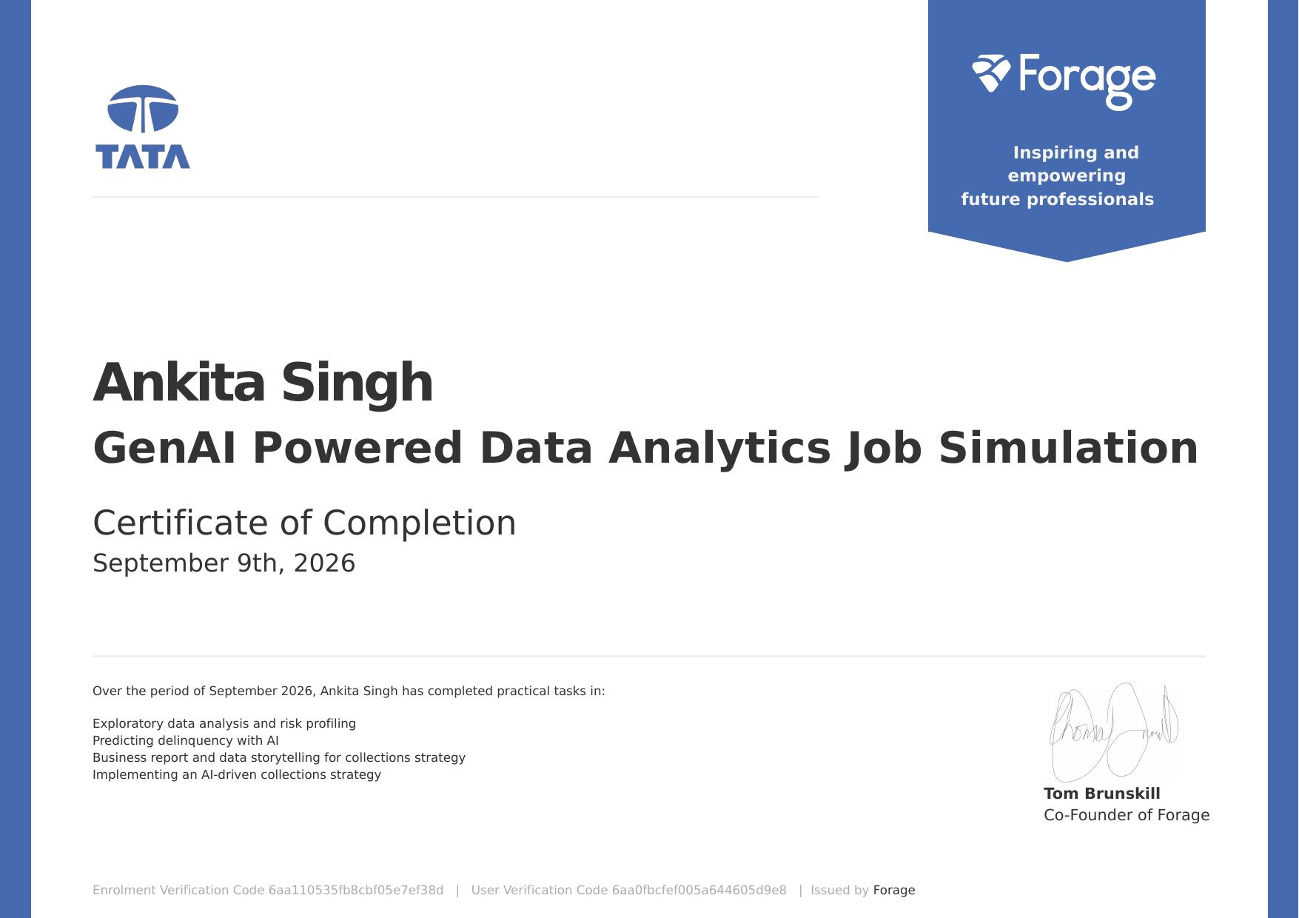
Certificate of Completion

Slide 12
Thank You!
ANKITA
Roll No: 25SCS1003004852
School of Computer Science & Engineering
IILM University, Greater Noida, U.P.

